Slide 1


micro:bit entry video tutorial
Lesson 20
micro:bit creative lesson 20 “Colorful gesture lights”
YahBoom micro:bit creative tutorial

Slide 2
micro:bit entry video tutorial
Content
Part1
Part 2
Part3
Part 4
Part 5
Learning goals
Preparation
Handmade
Search for blocks
Combine blocks
YahBoom micro:bit creative tutorial

Slide 3
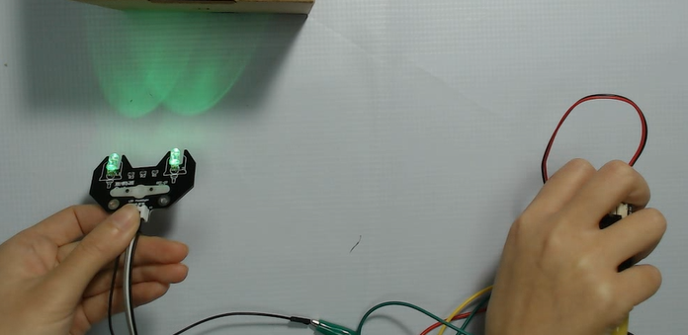
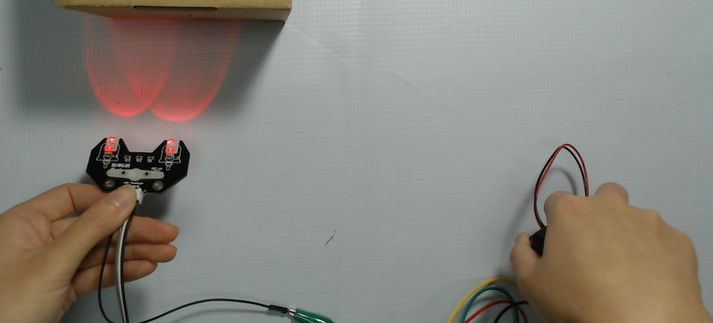
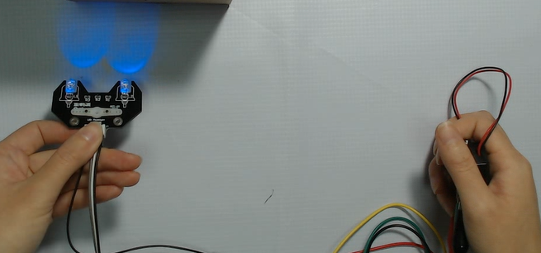
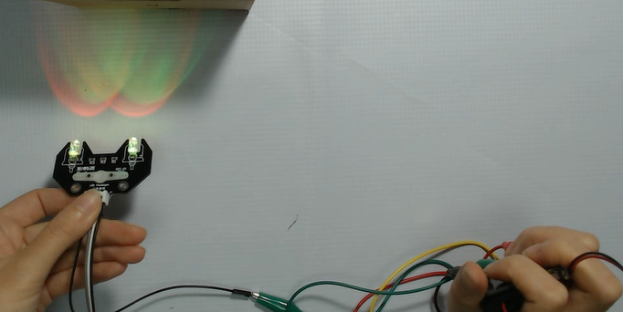
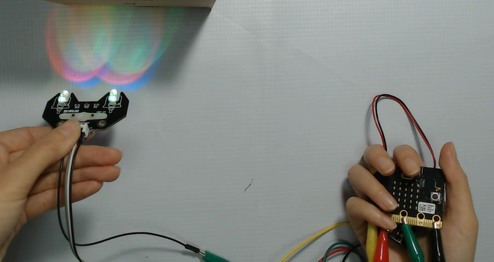
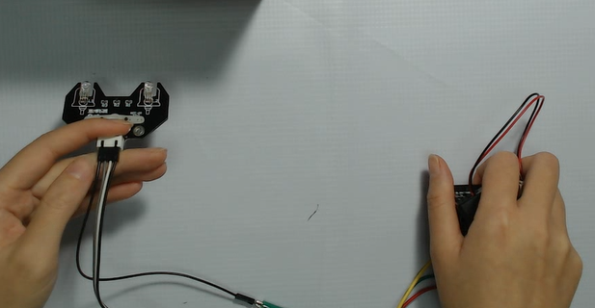
micro:bit entry video tutorial
Part 1
Learning
goals
After you download the program，we can hold the micro:bit and use gravity sensing of mirco:bit to make different gestures to control the color of the light as well as the light up and the light off. We can see in the picture, when we pick up the micro:bit and the array is up, it will light up the white light composed of red, green and blue. In addition, different gestures can also show red, green, blue ,yellow, etc.
YahBoom micro:bit creative tutorial

Slide 4
micro:bit entry video tutorial
Part 2
Hardware:
● 1 x Micro:bit Board
● 1 x USB Cable
● 1 x RGB module
● 4 x Dupont line
● 4 x Alligator clip
Preparation
Then the micro:bit is connected to the computer through USB,
and the computer will pop up a U disk and click the URL in the
U disk to enter the programming interface.Input this URL
https://github.com/lzty634158/yahboom_mbit_en to get the package.
YahBoom micro:bit creative tutorial

Slide 5
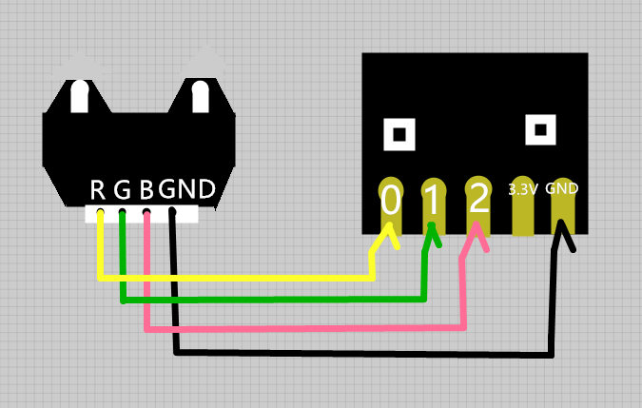
micro:bit entry video tutorial
Part 3
handmade
GND of RGB module connect to GND of Micro:bit
R of RGB module connect to P0 of Micro:bit
G of RGB module connect to P1 of Micro:bit
B of RGB module connect to P2 of Micro:bit
YahBoom micro:bit creative tutorial

Slide 6
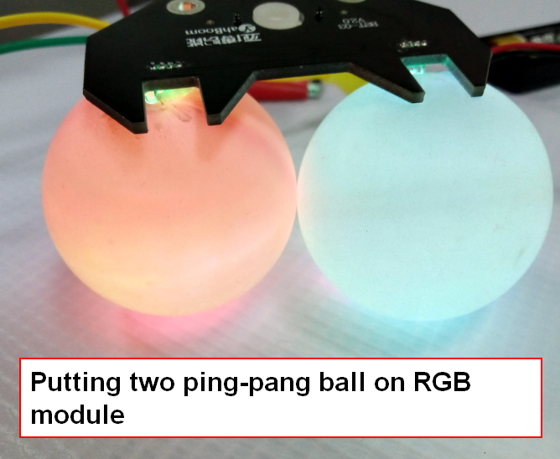
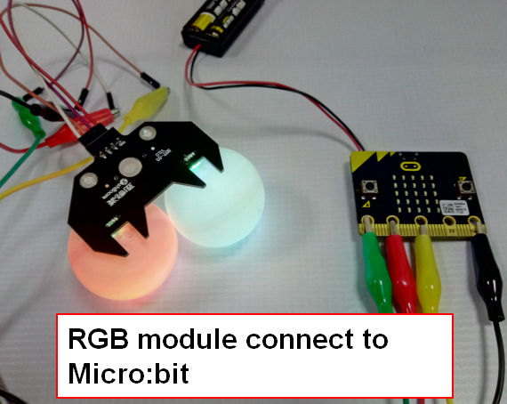
micro:bit entry video tutorial
Part 3
handmade
YahBoom micro:bit creative tutorial

Slide 7
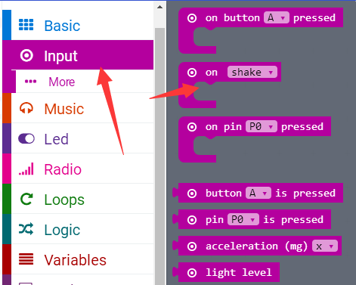
micro:bit entry video tutorial
Part 4
Search for
blocks
YahBoom micro:bit creative tutorial

Slide 8
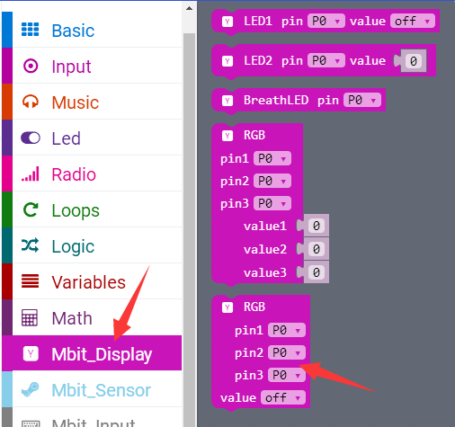
micro:bit entry video tutorial
Part 4
Search for
blocks
YahBoom micro:bit creative tutorial

Slide 9
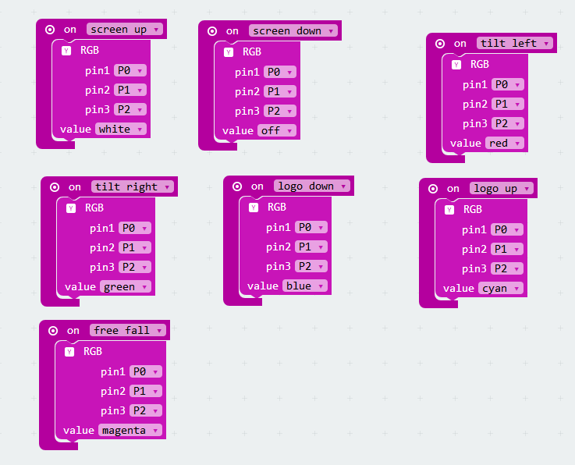
micro:bit entry video tutorial
Part 5
Combine
blocks
YahBoom micro:bit creative tutorial

Slide 10
micro:bit entry video tutorial
micro:bit
project
Thanks for watching!
Powered by
YahBoom
YahBoom micro:bit creative tutorial

